Slide 1
S.P.A
By Haim Adrian, Idan Pollak and Lior Shor

Slide 2
The project
SPA is a virtual electronic store developed by 3 student from the faculty of computer science, Holon institute of technology
We created a friendly desktop application with easy to use interface for both the users and the management
We developed the application using JAVA language
The application was develop in accordance to our architecture documents

Slide 3
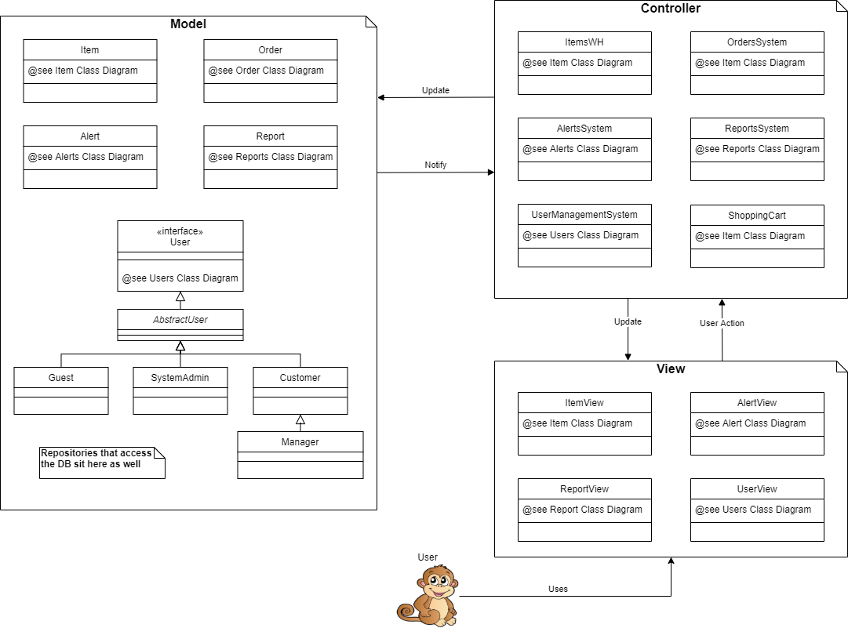
The architecture
The architecture we choose to work with in this project was MVC
We made a separation of the model from view and controller in order to make it easier to change the model layer with a DB access in the future. Hence the business Logic is implemented at the controller layer.

